Slide 1
Animatronics
Python with Robots Mission 4
Lesson 1 Objectives 1-3

Slide 2

Pre-Mission Warm-Up
In your Mission 4 Lesson 1 log, answer the pre-mission warm-up questions:
What line of code turns on a user LED?
What line of code defines a variable for delay?

Slide 3

Mission 4: Animatronics
You are hired by a major Theme Park!
Your task is to create a new animatronic robot exhibit.
Gotta write some Python code and get the show running with CodeBot!

Slide 4
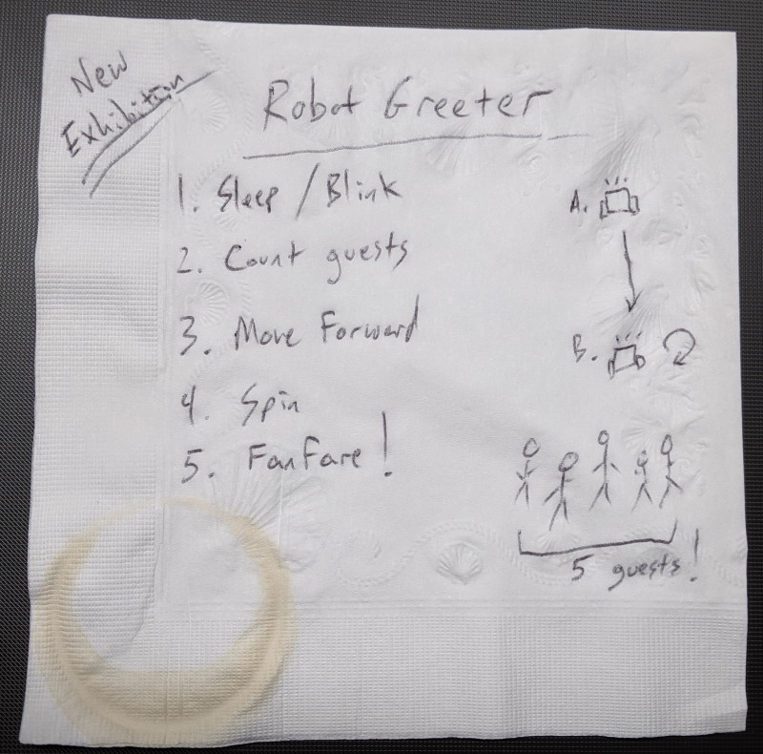
Mission 4: Animatronics
At a coffee shop meeting, the manager gave you a classic napkin sketch of what she’s looking for.
For this lesson, we will work on the first task:

Slide 5
Mission 4: Animatronics
Task:
The robot starts out “asleep”, constantly blinking red LEDs in a cool pattern.
Goal:
Blink red user LEDs constantly in a cool pattern.

Slide 6
Mission 4 Introduction Activity
DO THIS:
Answer the questions in your Lesson 1 log.
What is the first step outlined in the notes?
What is the first project goal?

Slide 7
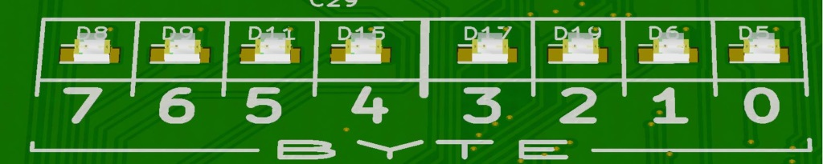
Objective #1: Forever Flashing
You already know how to turn the user LEDs on and off.
Use a sleep() to delay between blinks
The constantly part is new.
You can’t just copy and paste the blinking code forever.
You need a loop!

Slide 8
Objective #1: Forever Flashing
A loop:
A while condition: statement tells Python to repeat a block of code indented beneath it as long as the given condition is True.
The condition can be a Boolean value, variable or expression.

Slide 9
Objective #1: Forever Flashing
An infinite loop:
while True:
The condition is always True!
This is a loop that never ends.
The program won’t stop until you press the STOP button.

Slide 10
Objective #1 Activity
DO THIS:
Start a new file – SweepLEDs
Follow CodeTrek to write the code that blinks a single user LED. Run the code.
Change the value of n_led and run the code.
n_led = 1
n_led = 5
What is n_led used for?

Slide 11
Objective #2: A Cool Pattern
Now for the cool pattern part of this project.
Blinking a single LED isn’t very flashy.
But you also observed that you can change the variable n_led, and it changes the LED that is blinking.
You can use that information in your code!

Slide 12
Objective #2: A Cool Pattern
Updating a variable
You can assign a variable a new value at any time.
This is called “updating a variable.”
For example: n_led = n_led + 1
This doesn’t make sense in math class, but this isn’t math class.

Slide 13
Objective #3: Fixing a Cool Pattern
So what is going wrong?
There are only 8 LEDs.
n_led needs to be within 0-7.
It starts at 0.
What is its value when the error occurs?
You can use the debugger to view the value of n_led in real time.

Slide 14
Objective #2: A Cool Pattern
Very often the new value is based on the old value.
In this example:
n_led = 0 n_led = n_led + 1
The old value of n_led, which is 0, is added to 1. Then the new value, which is 1, is assigned to n_led.
This is like counting, which is very common in programming.
It is called “incrementing.”

Slide 15
Objective #2 Activity
DO THIS:
Practice with updating.
Look at the sample code in your mission log.
Write down the final value of the variable for each sample code.

Slide 16
Objective #2 Activity
DO THIS:
Follow the steps in CodeTrek:
Add a line of code to increment n_led.
Make sure it is indented!
Run the code.
Record the error message in your mission log.

Slide 17

Objective #3: Fixing a Cool Pattern
Using the Debugger.
Open the Console panel
Click on Debug
Change the view to DEBUG in the console panel, and open the Globals.

Slide 18
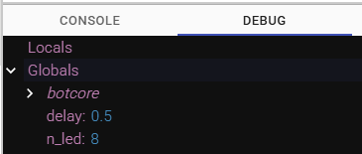
Objective #3: Fixing a Cool Pattern
Use the “Step In” feature to walk through the code.
Watch the two variables appear in the console.
Watch the value of n_led change as you step through the code.
Pay close attention to its values as you step through. Once the error occurs, the variables will disappear.
What is the value of n_led when the error occurs?
Write this in your mission log.
Close the console panel.

Slide 19
Objective #3: Fixing a Cool Pattern
You can fix the error with a little control flow logic. Use an if statement branch.
After incrementing n_led, check to see if it is 8.
If so, reset n_led to 0.
Indentation Note:
The if statement is indented inside the while True loop.
The if statement also starts a block of code, so it will have a second level of indentation.
This second block only runs when the if statement is True.

Slide 20
Objective #3: Fixing a Cool Pattern
The double equals (==) symbol
The double equals == is used for comparison.
It is a comparison operator, like < and >,
The single equals (=) symbol
The single equals = is used to assign values.
It assigns a value to a variable.

Slide 21
Objective #3 Activity
DO THIS:
Follow CodeTrek to:
Import sleep from the time library
Add the sleep() function after turning on each user LED.
Run your code.

Slide 22
Extensions
Here are some things to try:
Use two different delay variables – one for the light on and a different one for the light off
Use one delay variable, but make it a different value for on and for off.
You can use sleep(delay/2) or something similar.
Start with a very short delay and increment the delay when the n_led variable is reset.

Slide 23
Post-Mission Reflection
Complete the post-mission reflection in your Mission 4 Lesson 1 Log:
How are while loops and if statements similar?
How are while loops and if statements different?

